Slide 1
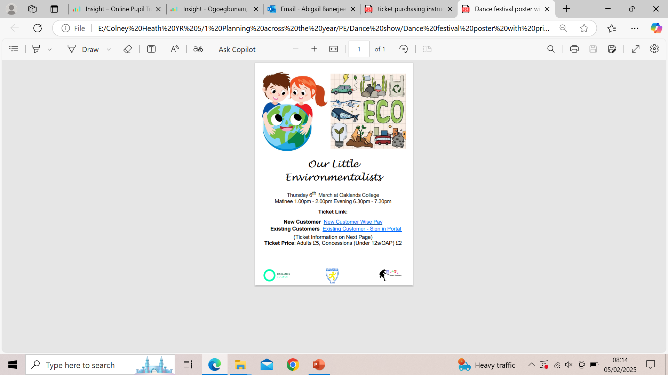
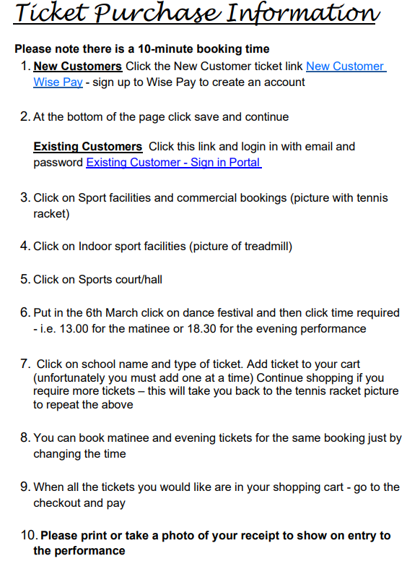

Slide 2
New customer link
Oaklands College External Services - Oaklands College External Services - Home Page
Existing customers
Oaklands College External Services - Oaklands College External Services - Home Page

Slide 3
Timings:
Show: “Our Little Environmentalists”
Date: Thursday 6th March
Venue: Oaklands College – Entrance via East Drive only
Times:
Arrive via car shares where possible. Meet Miss Banerjee at 9:45 am
Matinee performance 1.00pm- 2.00pm (audience will be invited to arrive from 12.30)
All children to leave after the matinee performance
Return and meet Miss Banerjee at 5:30 (same place as drop off)
Parents/ carers with tickets will be allowed in at this time too or can go and come back
Evening performance 6.30 – 7.30pm

Slide 4
Kit list:
Outfit must be in school for dress rehearsal February 25th - maybe bring it in the day before?
Outfit:
bottom half must be black or dark navy, leggins, shorts or tracksuits. Non branded or logos, plain. Preferably similar to PE kit.
Shoes that are plain black/dark trainers suitable for dancing in
Socks should be plain black or white and trainer socks (not knee high socks!)
A bright T shirt of any colour, not heavily brand logo’d though
A plain black or dark navy Zip front sweater or hoodie. Must have a zip or easy fastening
Other things children will need for the day:
A water bottle (full and can be refilled!)
Packed lunch and snacks for the afternoon. No nuts or sweets or chocolate that wouldn't usually be allowed in your school packed lunch.
Children can bring one book or a small notepad and a few pens, for any quiet moments between rehearsals, but NO toys. It is unlikely there will be any downtime anyway.
Those who are allowed fidgets in class (they know who they are, feel free to check with me) this is extended to this day too out of class and so one fidget is allowed.
Please share these amongst yourselves if you have multiple items. Contact me for any help.

Slide 5
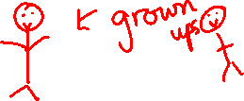
Where to sit!
Facing the front
Evelyn, Caoimhe, Leyla, Jakub, Zayn, Samuel, Zion, Oliver S
Right
Shossy
Dolly
Harry
Aydin
Jordan
Alex
Oliver w
Theo
Owen
Youssef
Ophelia
Holly
Left
Megan
Frankie
Ellie
Adam
Evie
Malachi
Alexis
Borys
Julia
Ailbhe
Stage
Children facing out
Direction based on facing the stage

