Slide 1
Snow Day Learning !
For Year 5 by Miss Banerjee

Slide 2
You can do this work in any order you like.
You can do it in your homework book or on paper.

Slide 3
Happy Snow Day!
I am so excited that it is snowing! Here is some work for you to do while you are wrapped up warm inside!
First of all, some snow safety rules!
1. If you go outside, you must be wrapped up warm!
2. Don’t go anywhere near water when it has snowed, lakes and rivers might look safe to play on but they can be dangerous!
3. No snowballs to the face!
4. HAVE FUN!

Slide 4
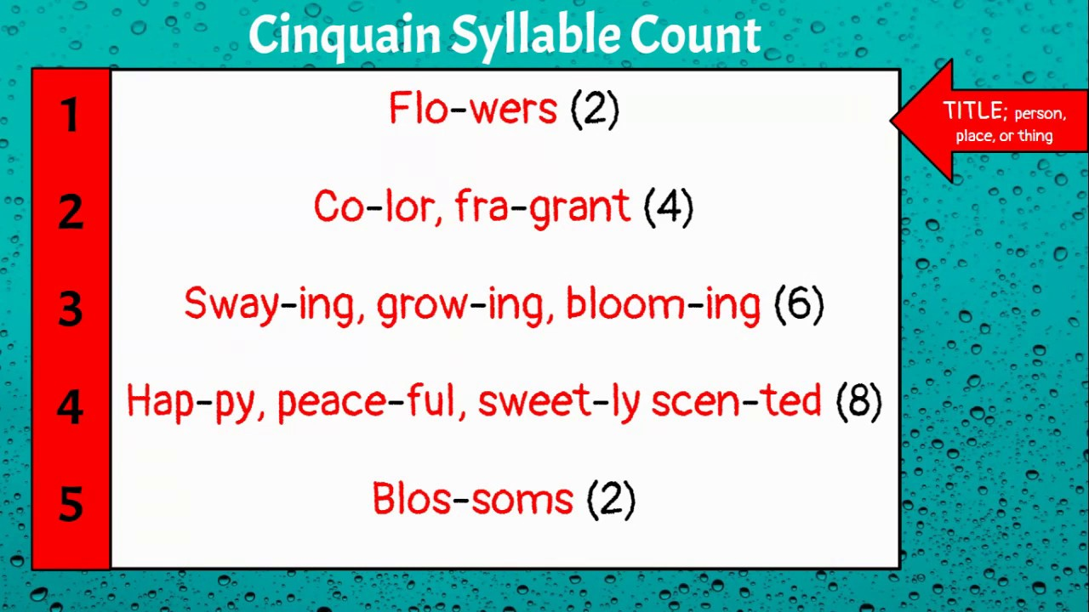
English! Write a snowy cinquain poem!
Sit at a window and look outside, write a cinquain poem. Remember to follow the syllable count.

Slide 5
English
Write a small section of speech (true or made up) about the morning of a snow day.
Here’s my example.
“Wake up! Wake up! It’s snowing outside!” shouted Mum, while boiling the kettle.
Miss Banerjee, excited and a little confused, jumped out of bed and ran to the window to see.
“Oh Wow! Do you think school will be open today?” she asked inquisitively, with her fingers crossed.

Slide 6
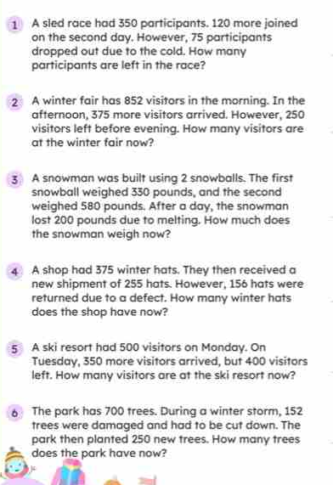
Maths addition and subtraction problems
Remember to show your workings out.

Slide 7
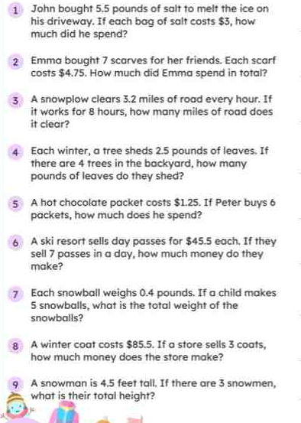
Maths Multiplication problems
Remember to show your workings out.

Slide 8
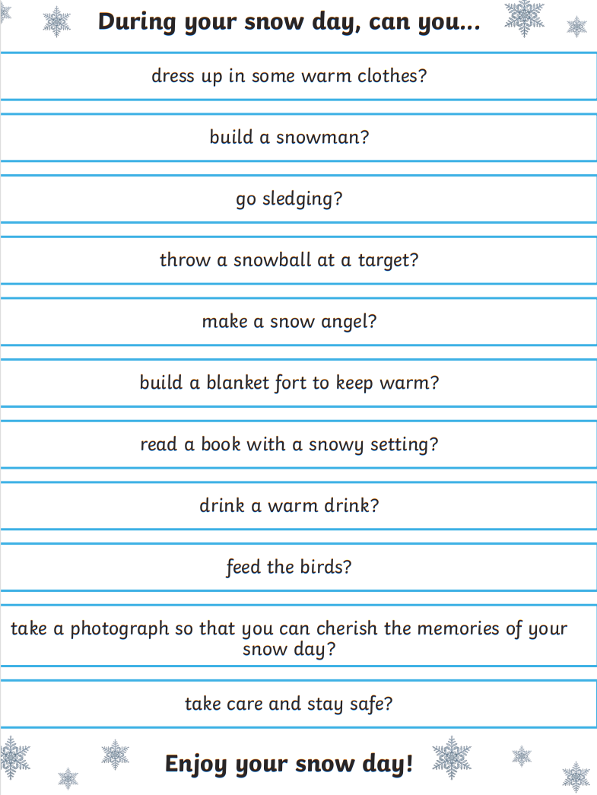
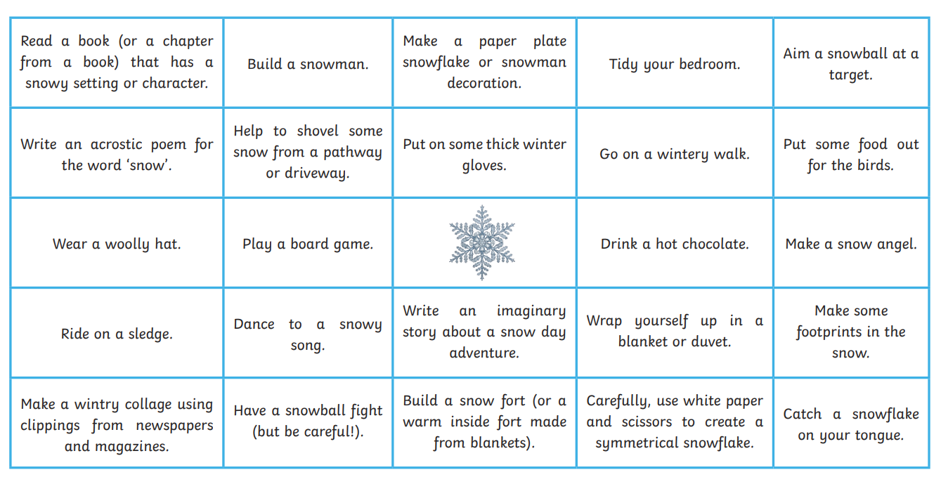
Some snow day challenges!
Snow day bingo!

Slide 9
Pe
Go outside and enjoy the snow!! Play kindly, run around, throw snow balls and build snow men! I can’t wait to see lots of pictures!

Slide 10
As always, let’s end the day with a story!
Once you have played outside, come inside and get warm, cosy and comfortable. Find your favourite spot, with your warmest outfit and with your favourite drink and snack. Choose your favourite book and read! ☺

